Slide 1
SmoothMigration x NBC landing page

Slide 2
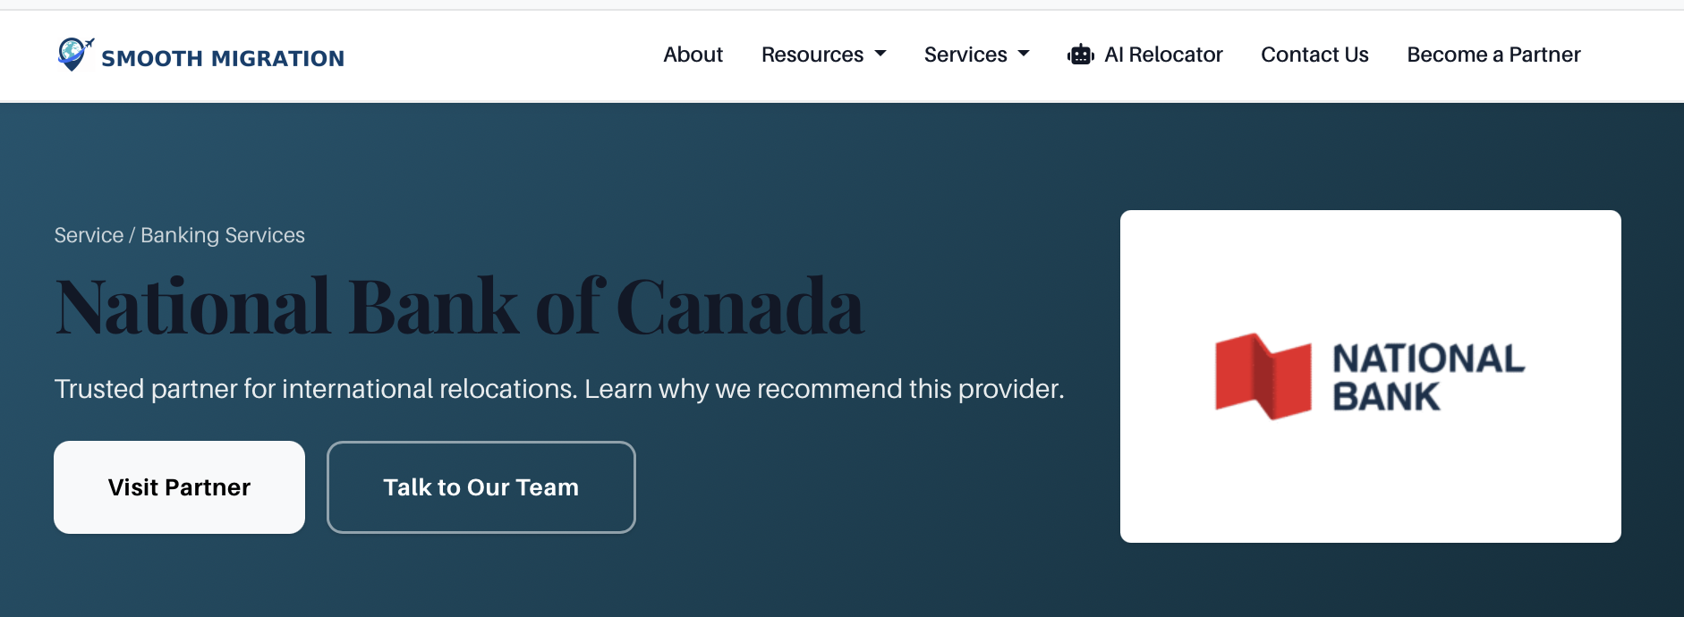
Copy: Discover solutions tailored to your needs to help you make the most of your future in Canada.
Get $550 cashback when you open your first chequing account and up to 3 years with no monthly fee
CTA: Replace 'Visit Partner' with 'Advice on getting settled' = linking to: https://www.nbc.ca/personal/switch-national-bank/newcomers/guide.html
CTA: Replace 'Talk to our Team' with 'Open an Account Online' = linking to: TBD

Slide 3
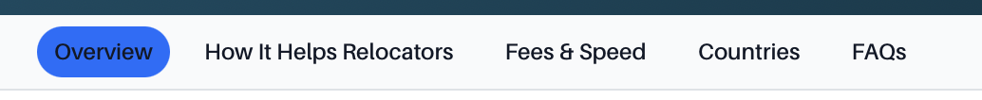
Replace 'Overview' with = Why choose National Bank
National Bank of Canada is one of Canada’s six largest banks, with a dynamic presence across key financial segments such as personal, business, and international banking. Offering a wide range of products and services, National Bank is committed to providing high-quality service. Discover why National Bank was named the top bank for newcomers by MoneySense in 2024 and how they're helping their clients build their future in Canada.

Slide 4
Replace 'How it helps relocators' with = How they help newcomers
National Bank makes handling your everyday transactions simple. From getting the credit card that best fits your needs, to creating a long-term financial strategy, National Bank’s services for newcomers are designed to give you the tools and support you need to build your future in Canada.
Take advantage of a wide range of banking products and services to manage your finances more confidently and build your projects in Canada.
Unlimited electronic transactions and Interac e-transfers®; plus access to mortgages, auto loans³, business accounts, investment solutions and more.
Come visit us at one of our over 360 branches, or access one of our 2,000 automated banking machines across Canada.³
Access your funds abroad by making withdrawals at an ABM using our network partners around the world.⁴
Your deposits with National Bank of Canada are protected by the Canada Deposit Insurance Corporation (CDIC).
Save on your first order of 100 cheques (not including tax and shipping).

Slide 5
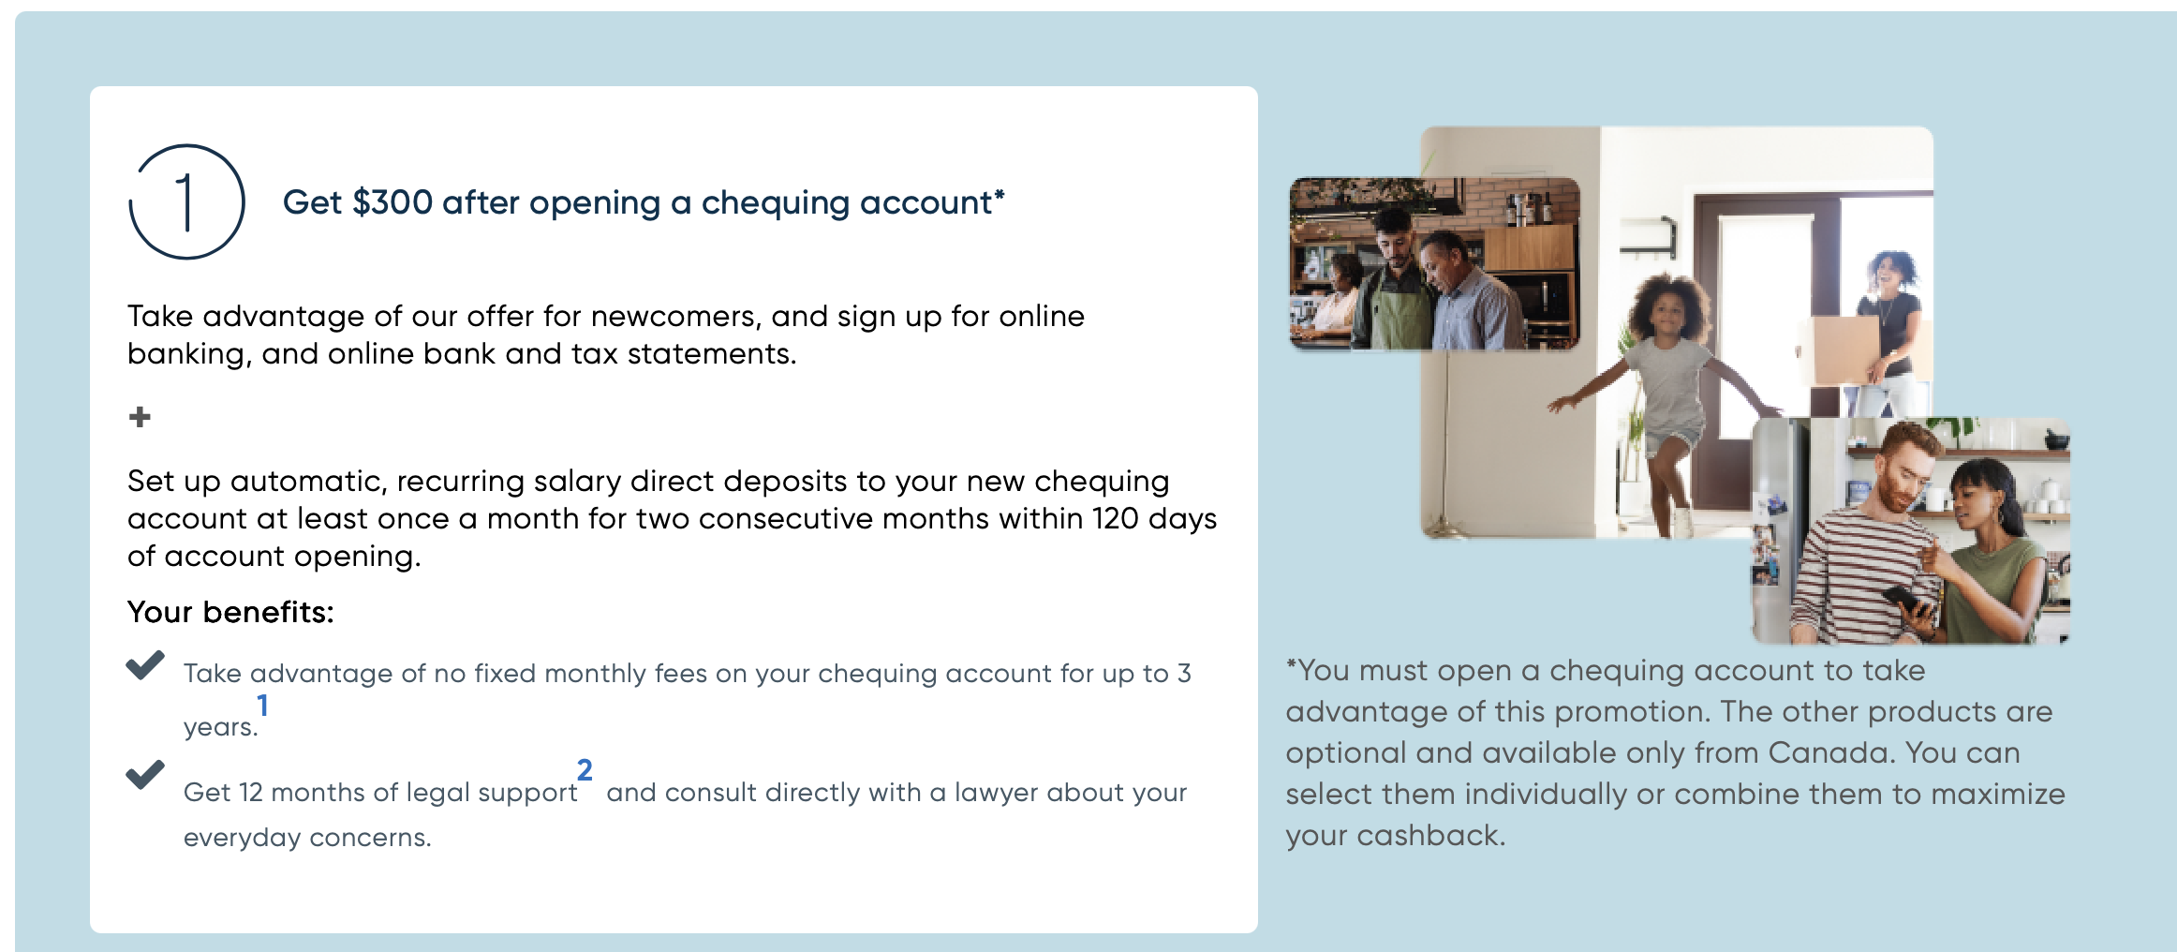
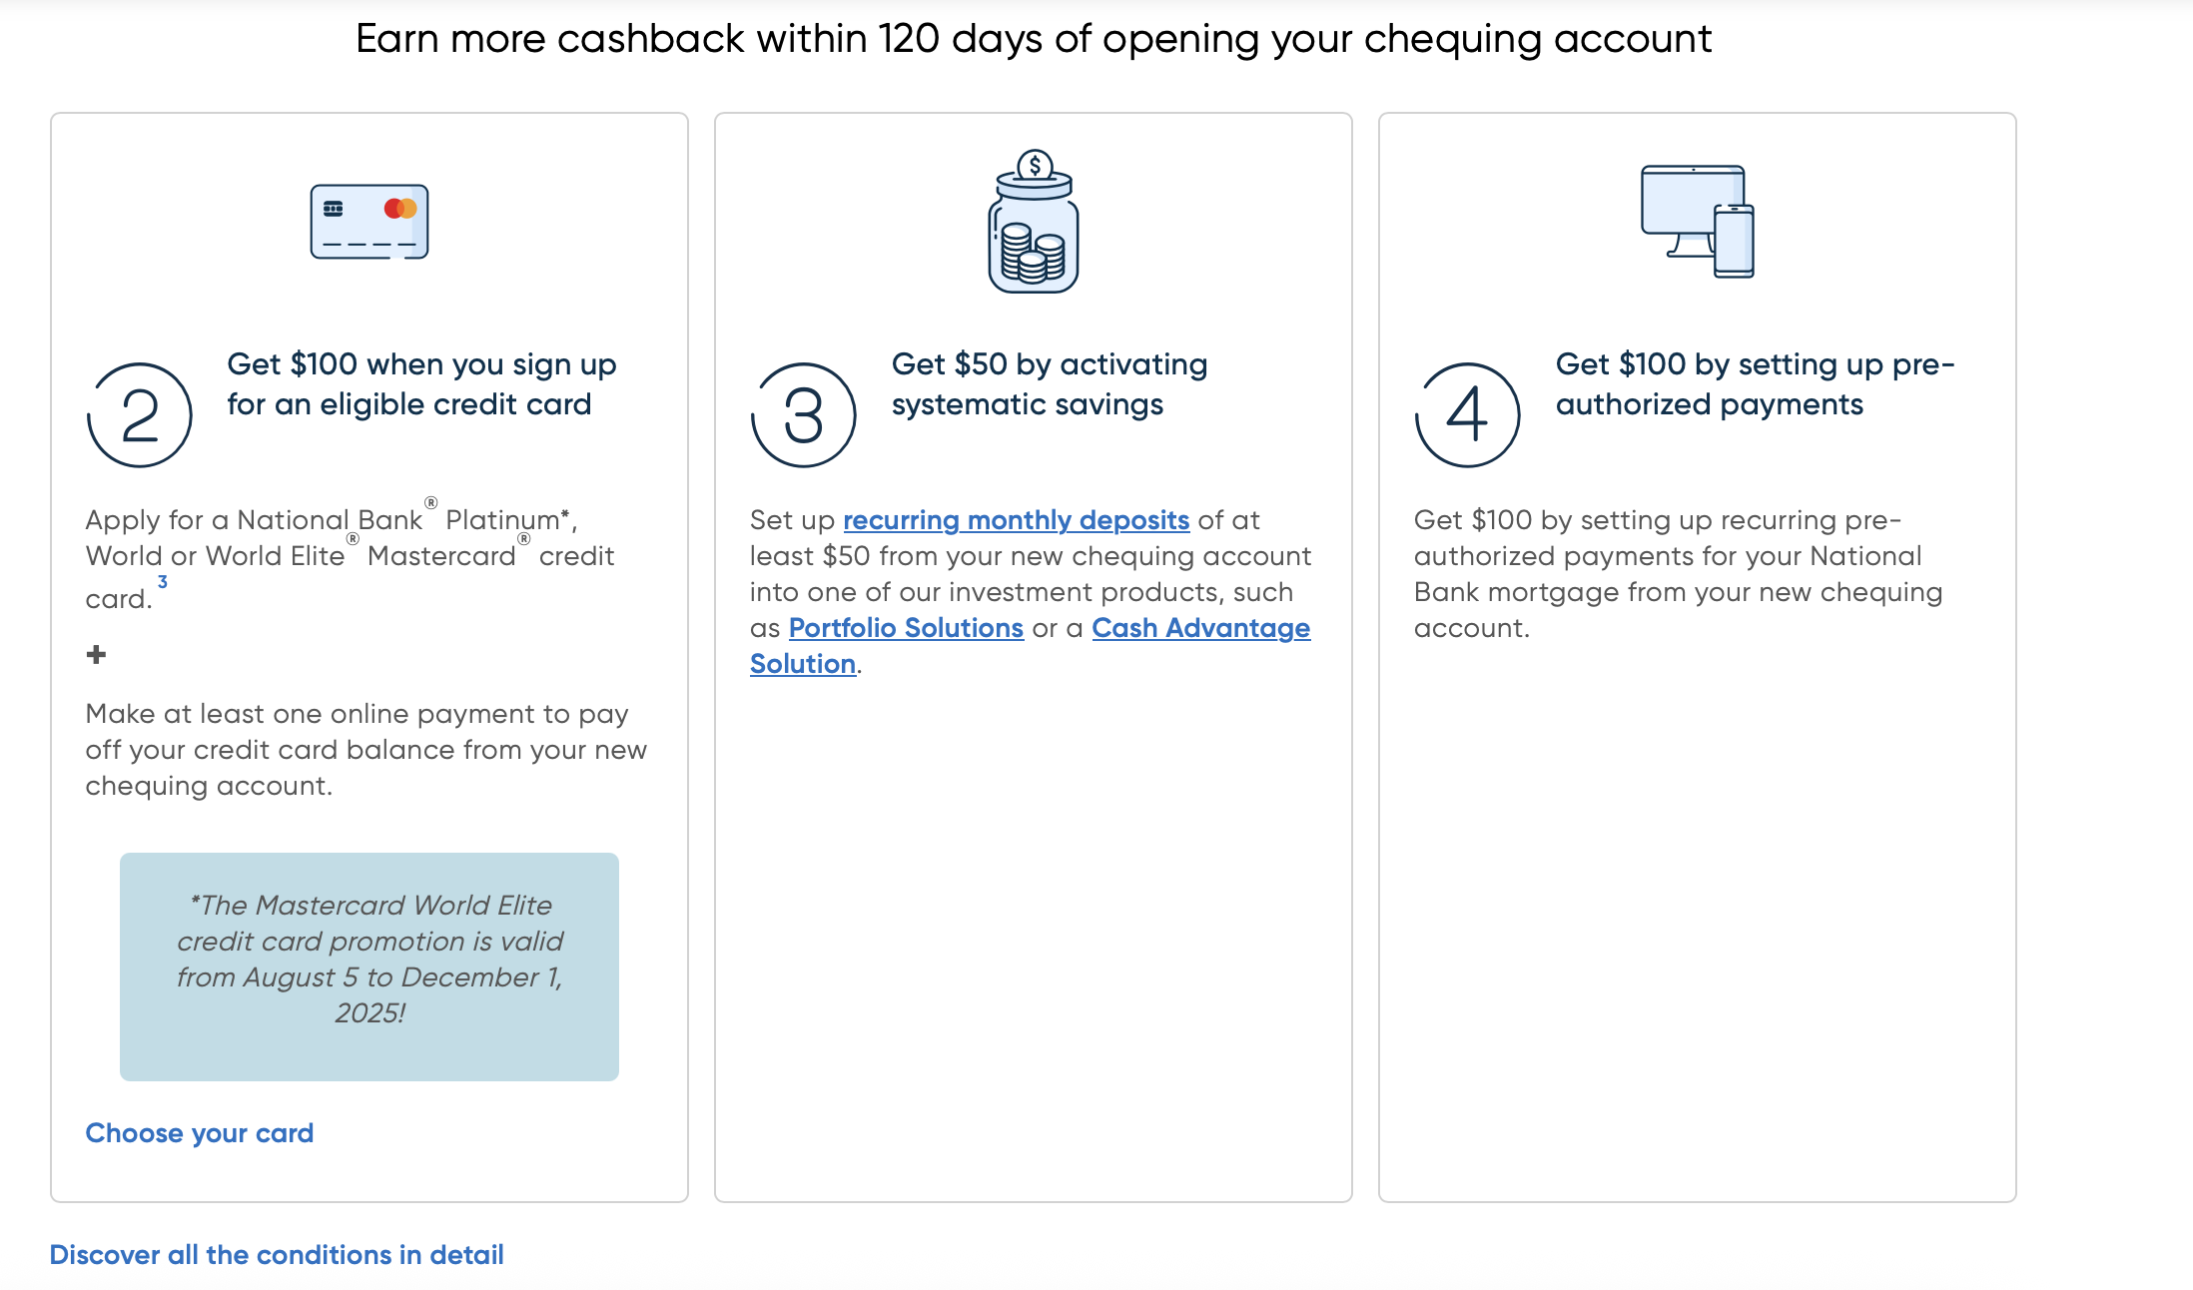
Replace 'Fees & Spend' with = Offer for Newcomers
Get up to $550 cashback to help give your Canadian projects a boost
Your success in Canada starts here, with our special promotion for newcomers. All you need to do is open a chequing account, then add other eligible banking products to the offer by completing the necessary transactions.* Take advantage of this offer from 90 days before your arrival and up to 5 years afterward. ¹
Source: https://www.nbc.ca/personal/accounts/newcomers.html

Slide 6
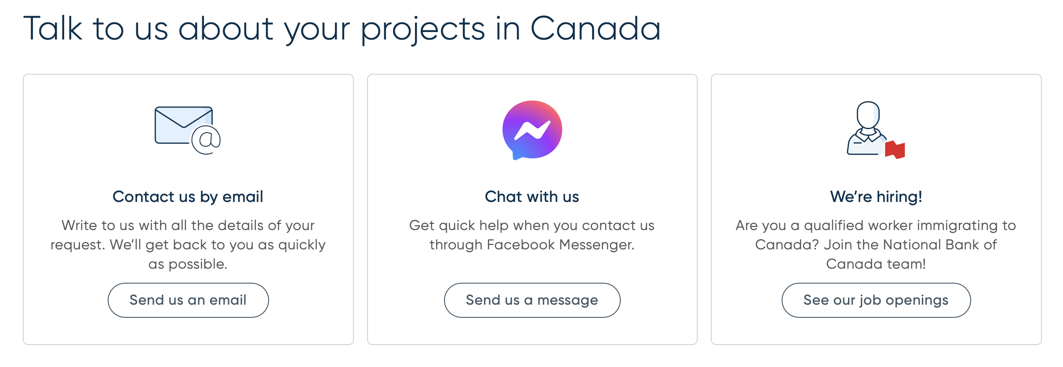
Replace 'Countries' with = Contact
Source: https://www.nbc.ca/personal/accounts/newcomers.html

Slide 7
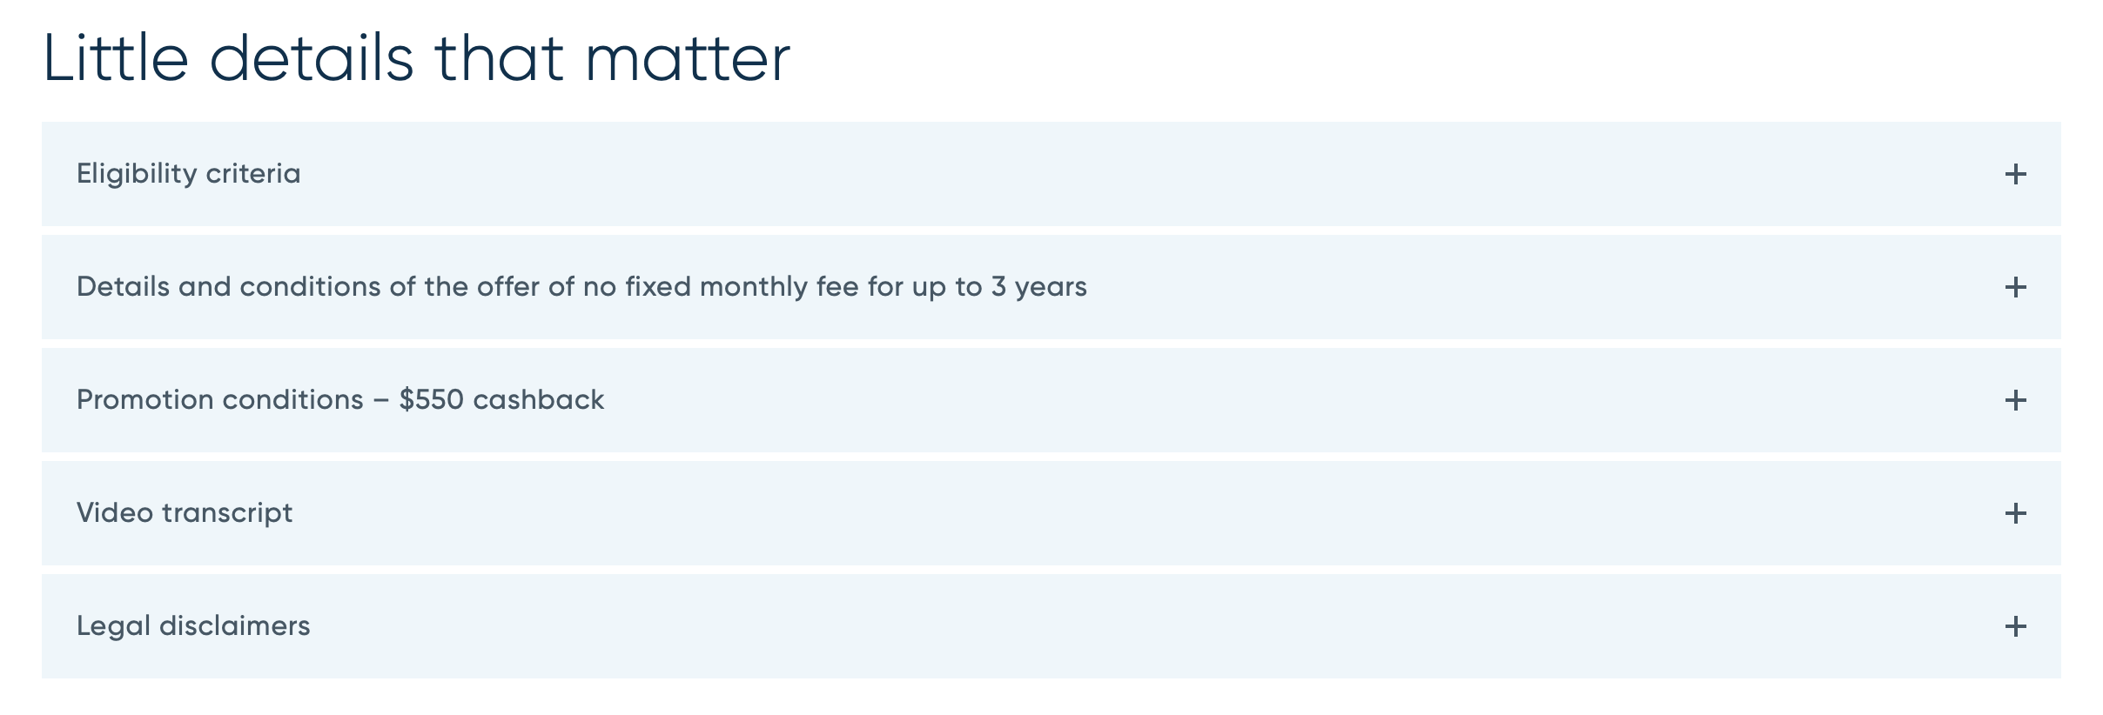
Replace 'FAQ' with = Little details that matter
Source: https://www.nbc.ca/personal/accounts/newcomers.html

Slide 8
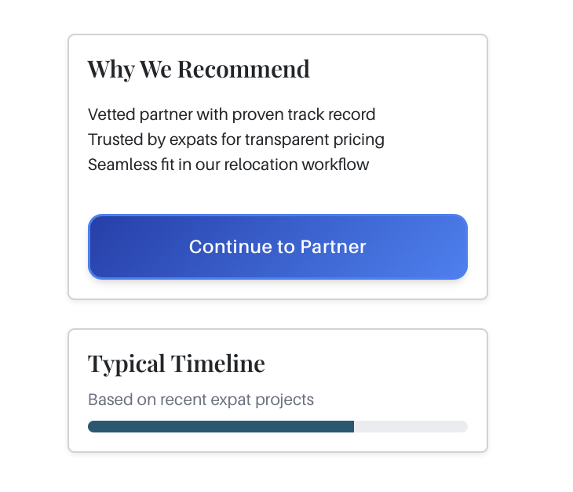


Why we recommend National Bank offers award-winning banking services for newcomers with transparent pricing and in-depth support

Slide 9
Typical Timeline
Take advantage of this offer from 90 days before your arrival and up to 5 years afterward. ¹

Slide 10
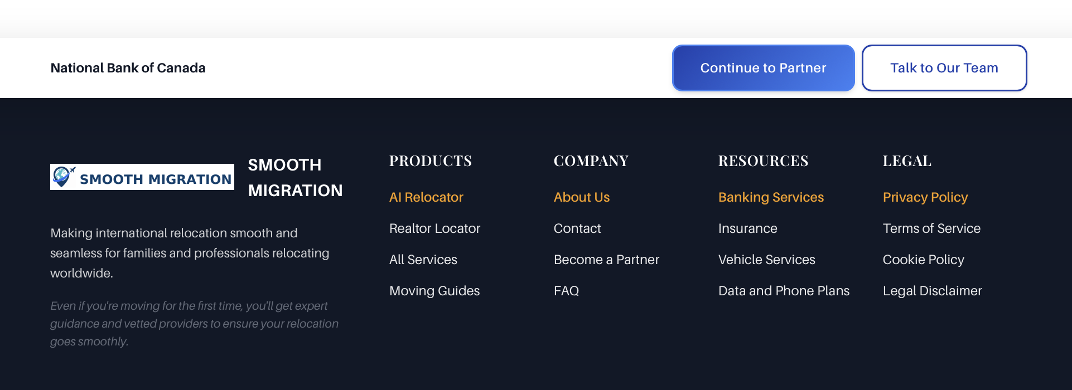
CTA: Replace 'Continue to Partner' with 'Advice on getting settled' = linking to: https://www.nbc.ca/personal/switch-national-bank/newcomers/guide.html​
​
CTA: Replace 'Talk to our Team' with 'Open an account online' = linking to: TBD​

